Slide 1
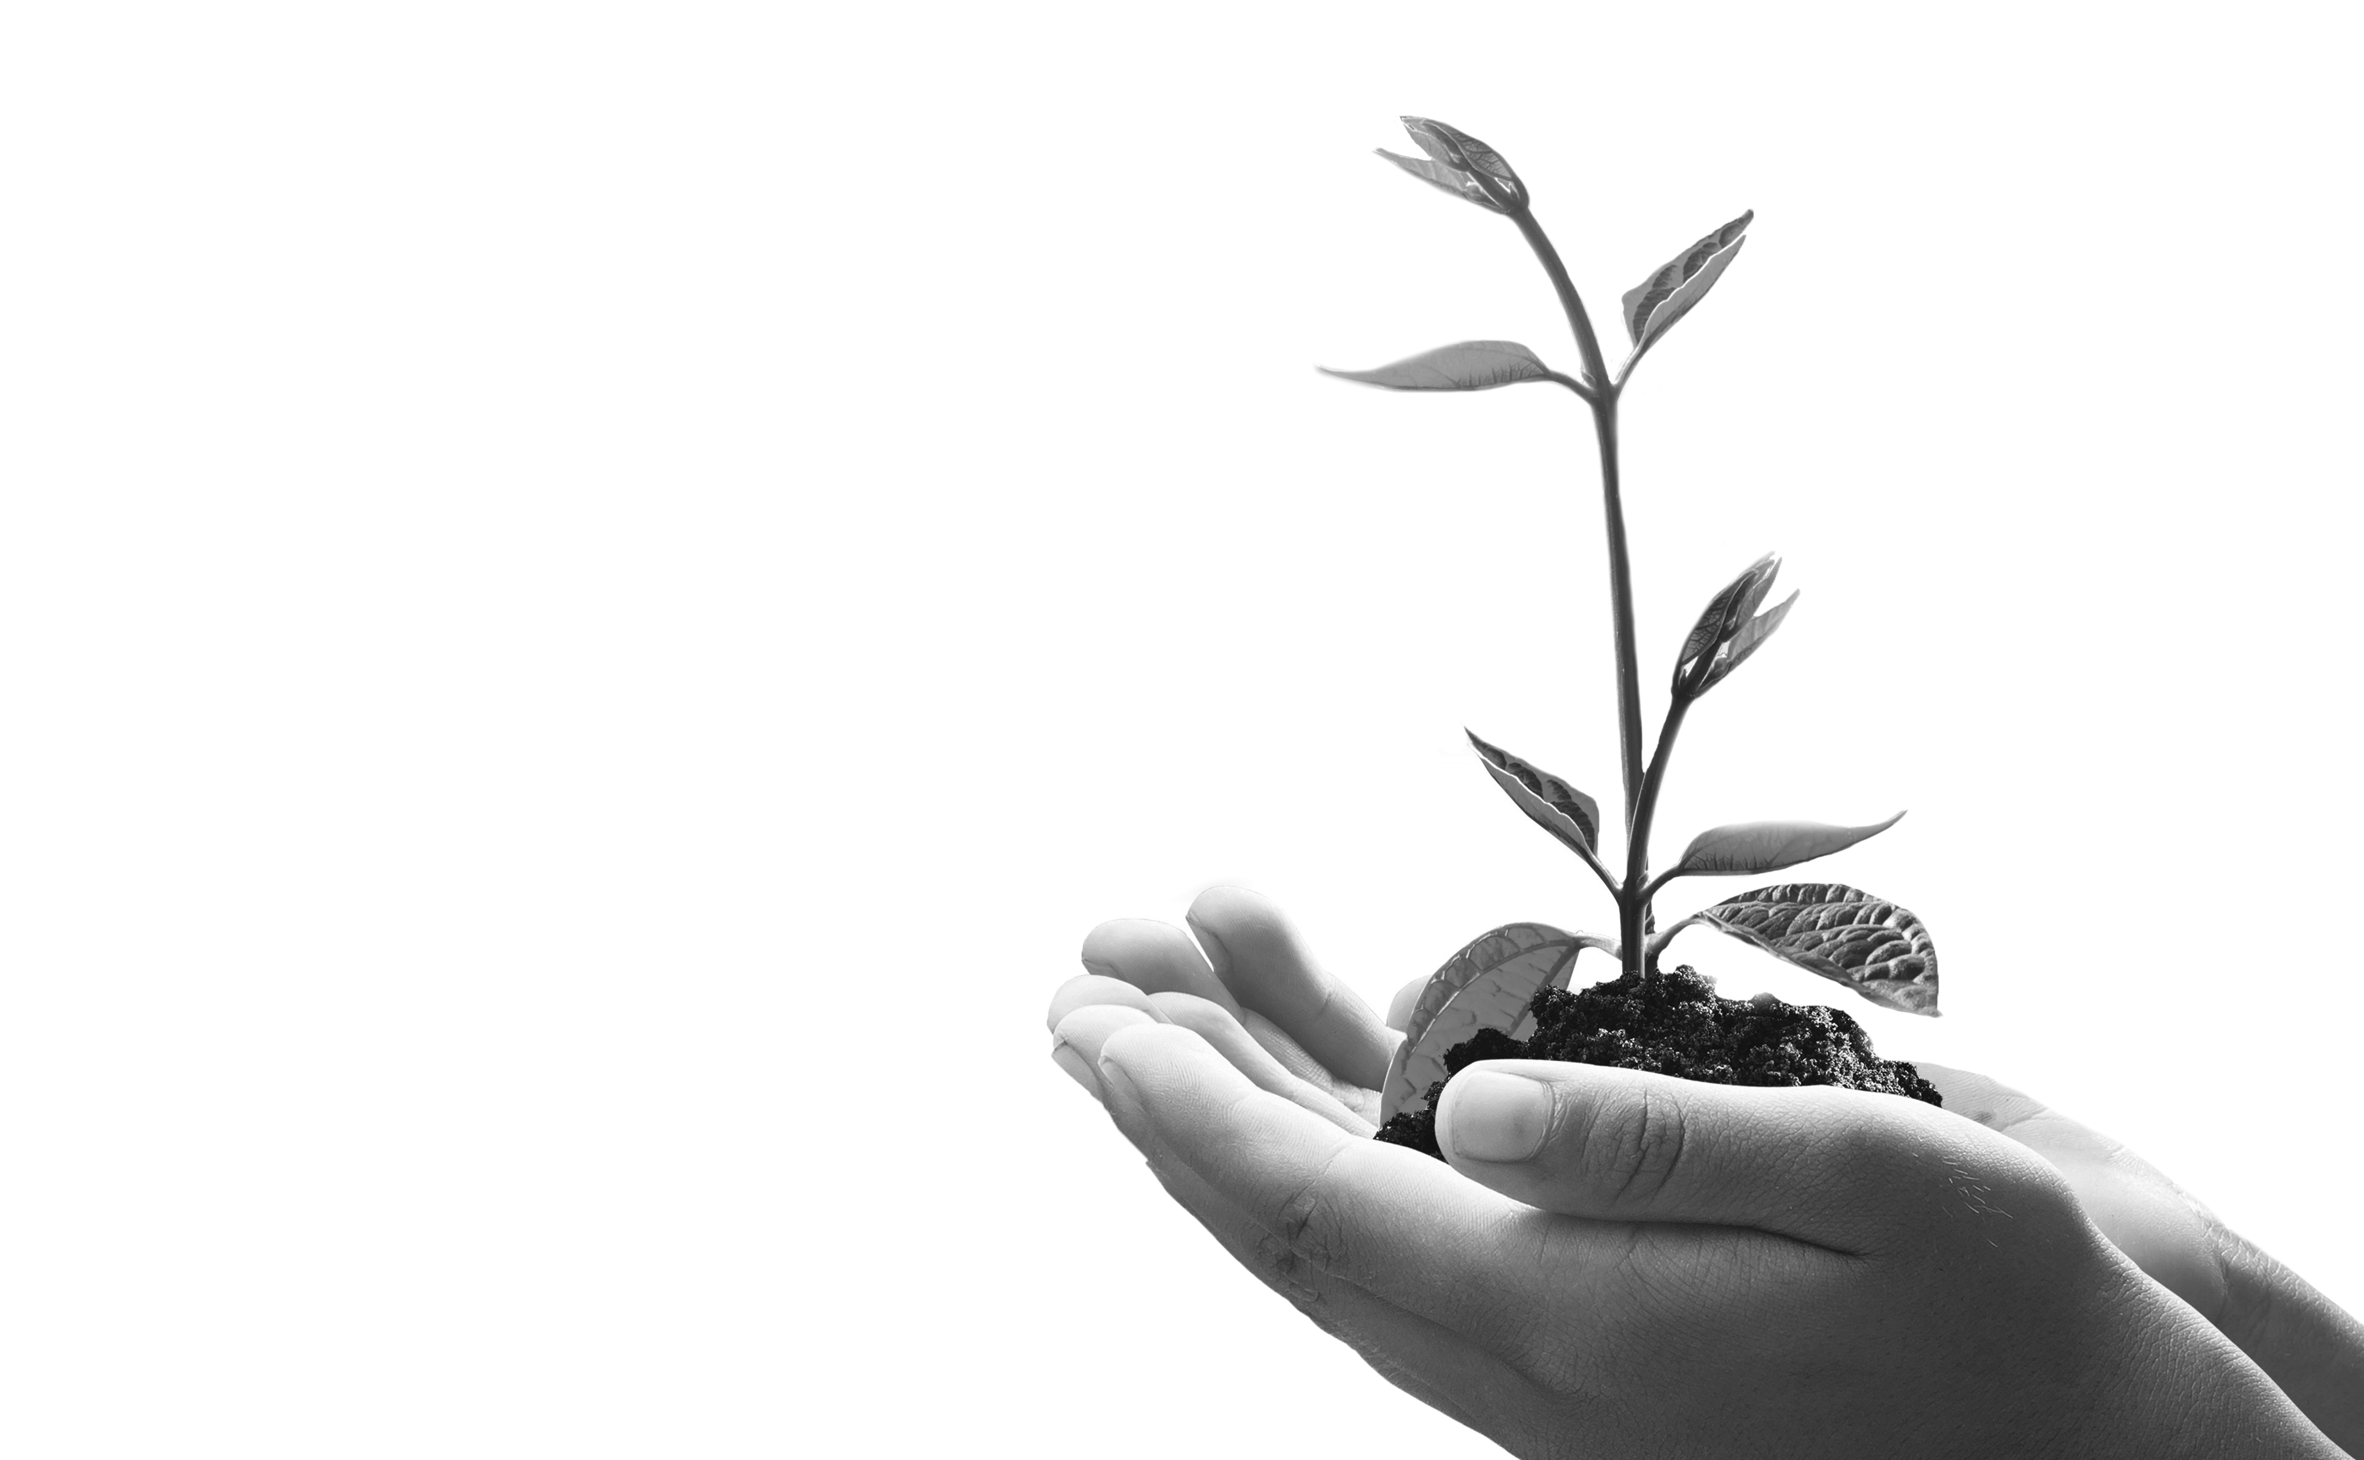
The Agri Workforce of the Future

Slide 2
A disruptive conversation

Slide 3
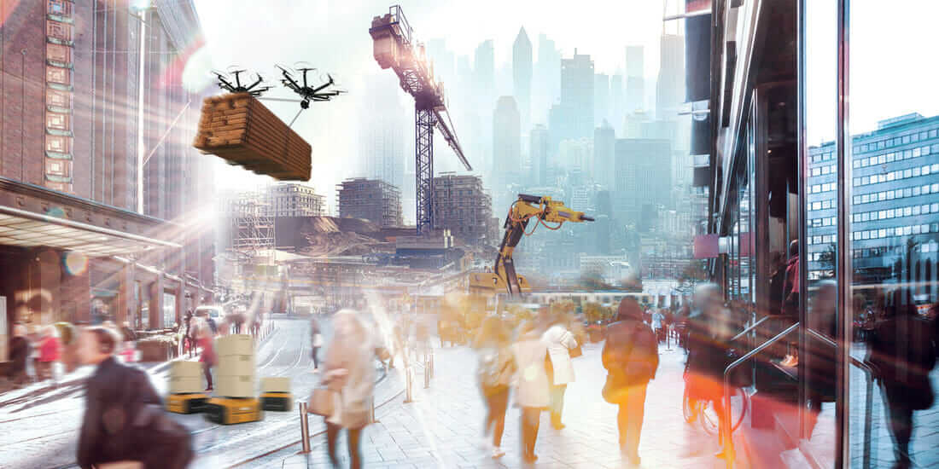
The World We Live In
“mega trends” of technological breakthroughs
climate change
rapid urbanization
growing population
digitalization
resource scarcity
ageing populations
smart…..everyting
shifting global economic power
rise of artificial intelligence
Notes:
If you think back to 15 or 20 years ago, the workplace was much different. Computers were used in business of course, but offices, restaurants, and factories were not the technology-filled places they are today. There were no touch screens, robots were rudimentary at best, and there were no real social networking sites or smart phones. People reported to the office each business day, and few people worked from home. If a call came in, a worker may have had to manually write down a message by hand

Slide 4
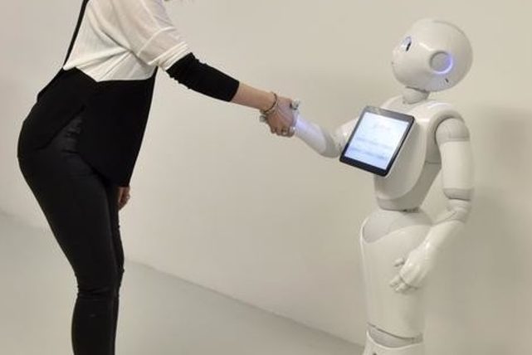
The World of Work in 2030
Do we think about it?
Do we read about it?
Do we understand it?
Do we belief it?
Do we strategize for it?
Do we align the workforce for it?
Are we ready for it?

Slide 5


The Red World | The Blue World | The Green World | The Yellow World
INNOVATION DIGITAL | POWERFUL CORPORATIONS | CORPORATE SOCIAL RESPONSIBILITY | FINANCIAL TECHNOLOGY HUMANITY
projects @ fast pace specialists thrive if they last automation of services outsourced specialization little regulation fewer benefits for employees | performance in workplace pushed to limits human effort maximized through physical and medical enhancement automation and technology analytics innovation | social ethos triple bottom line competition for talent remain intense paid leave a year to work on charity and social project | artisanal skills return arts workers guilds revived a world where humanness is highly valued non-financial rewards work is a fluid concept & the divisions between home and work blur.
Risks are high if innovation outpaces regulation. | While rewards for some will be high, the price will be people’s data/ no privacy | However, workers are expected to reflect their employers’ values at work and at home and travel is tightly controlled. | Conflicts remain around the use of technology, as people are less likely to take the downsides of automation without a fight.

Slide 6
The Red World | The Blue World | The Green World | The Yellow World
INNOVATION DIGITAL | POWERFUL CORPORATIONS | CORPORATE SOCIAL RESPONSIBILITY | FINANCIAL TECH & HUMANITY
Digital platforms the norm to find talent— like a superpowerful LinkedIn. Apps and tools that alert you when your organization needs new skills or capacity | Sophisticated connection between technology and performance. Top talent is fiercely fought over. Advanced metrics and sensors applied | CEO driven HR to become People and Society Success depends on creating the right culture & behaviors Guard against sustainability and reputational risk. Rewards for total beings | Core HR functions by business leaders & guilds. Certified: made by humans Conflict technological advancement vs humanity Fair pay
In-demand skills = highest rewards. Contracts: such as co-ownership of IP and the freedom to work. Workers left to sink or swim. Performance judged mainly on short-term results - deliver results, and fast. | Super-workers Worker consent to obsessive data analytics Health and wellness services provided by companies Specialized workers Our of ordinary rewards | Performance measured ito ethics and social conscience Family friendly workplace; flexible work hours; social project involvement. Trust and fairness. | Loyalty to similarly skilled Powerful guilds -to protect, support, and connect independent workers

Slide 7
Collaborative
Unpredictable
Fast Moving
Tough
New Paradigms
Beyond High Tech
Virtual
Complex
Automated
Digital/ Big Data
Non-Private
Difficult to regulate
Innovative
Fluent

Slide 8
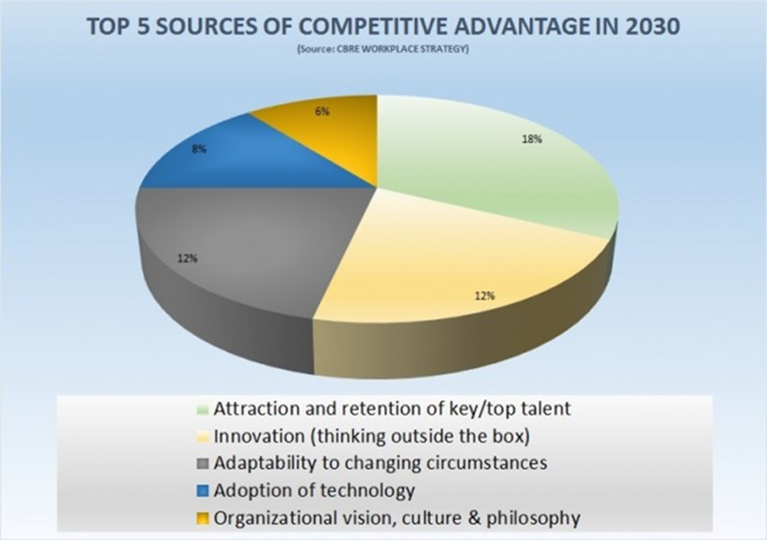
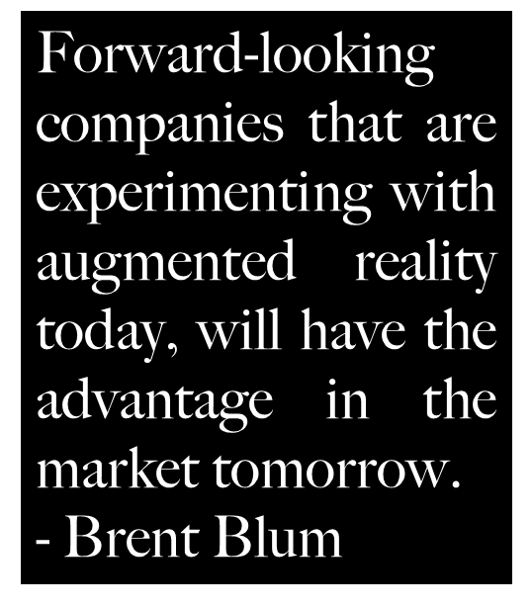

Slide 9
The World of Work in 2030
Both workers and employers value quality over quantity
The future workplace seems to focus more on quality metrics, like the acquisition of top talent, innovation, and culture. More and more corporations will achieve profitability by increasing quality, rather than cutting costs.
Employees of the future (millennials and beyond) may value a quality workplace, over a higher salary as well.
More and more workers work “with” companies, instead of “for” them
In 2030, we’ll probably see more consultants and freelancers. “An increasing number of freelance individuals, small groups and partner businesses won’t work for you. Instead, they will opt to work with you
Work and life become more intertwined
85% of Forbes 1000 companies leaders believe that work and life will become more enmeshed for more people by 2030

Slide 10


The World of Work in 2030
A virtual world of work ( virtual, global, and flexible)
Many corporations will require both a physical and a virtual space, but online space will be predominant, and the value of the corporation’s virtual space should be higher than its physical space.
More flexible work arrangements as corporations use virtual employees
working flexible schedules to cover all of this ground.
8am-5pm
Future of Work Report; World Economic Forum, 2017

Slide 11
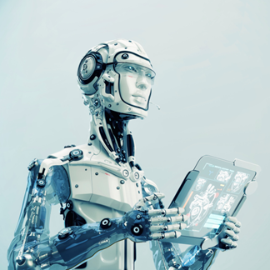
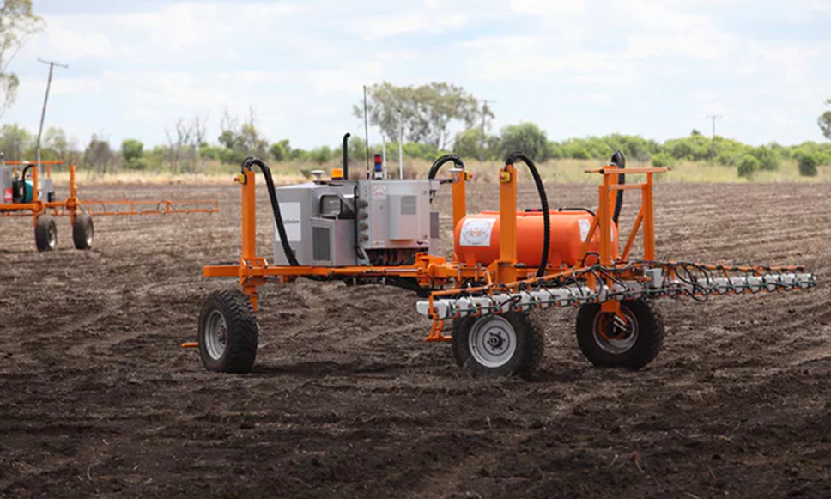
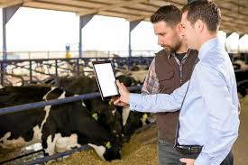
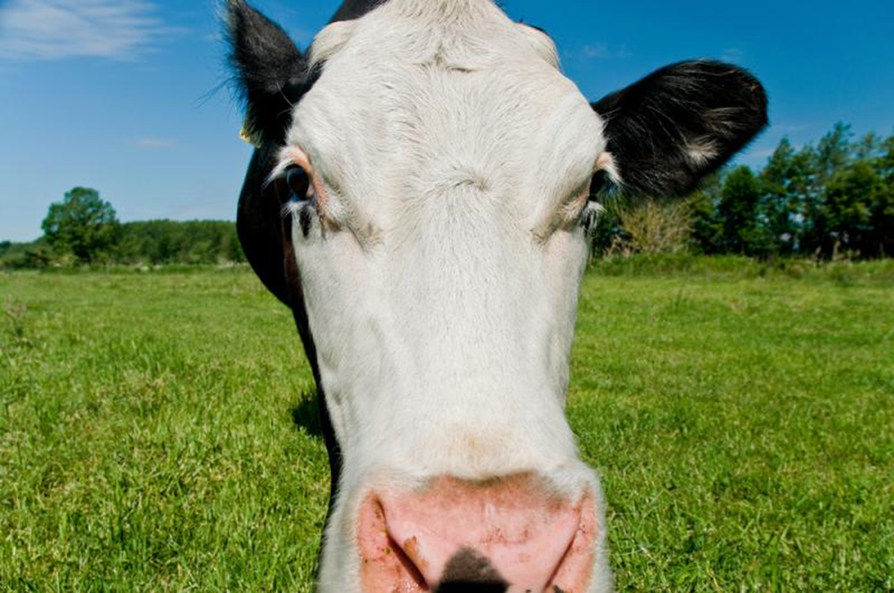
The World of Work in 2030
Technology takes the workplace to new heights
Across all fields ranging from virtual reality to robotics, technology is
evolving at a rapid pace, blurring the lines between science and
science fiction.
Future of Work Report; World Economic Forum, 2017

Slide 12
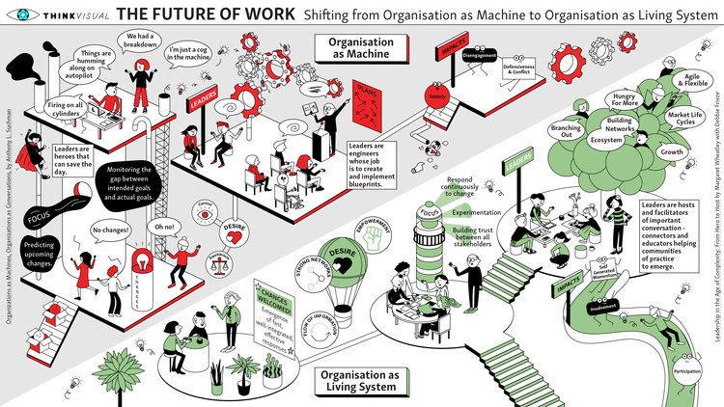
The World of Work in 2030
Collaborative World

Slide 13
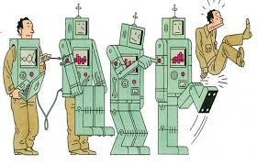
The World of Work in 2030
The combination of big data and smart machines will take over some occupations wholesale. Jobs will disappear, no more pilots, receptionists, silo operators, book-keepers, IT techies...
Being newly able to do brain work will not stop computers from doing ever more formerly manual labour; it will make them better at it. End of seasonal weeders, planters, harvesters, drivers, typists, data-capturers.
New data-processing technology could break “cognitive” jobs down into smaller and smaller tasks, whilst opening the way to eventual automation - this could reduce the satisfaction from previously highly paid work such as lawyers, accountants, Safex traders, etc.
Technology and the speed of data evolution will raise the pace at work
47% of job categories may be automated within two decades

Slide 14
Jobs of the Future
Software developer jobs will grow 18.8% between now and 2024, while computer systems analyst jobs will increase 20.9% by 2024. Market research analyst and marketing specialist jobs, which also require those analytical skills, will increase 18.6%.
Medical technicians, physical therapists, and workplace ergonomics experts will increase.
Veterinarians will also be in demand.
Sales and related jobs are one of the top five growth areas worldwide, according to the WEF report. In the U.S., BLS projects that jobs for retail and other sales representatives, marketing specialists, and customer service representatives are each projected to grow between 6.4% and 18.6%, depending on the category by 2024.
Going to take a long time for robots to be good at soft skills, like social and emotional intelligence and cross-cultural competency, ‘which are hugely valuable in a world where you or I could go and be working with somebody in the Philippines within an hour’, hence HR Cultural acclimatization specialist will be in demand.
Teachers and nugget trainers made Challenger’s firm’s list of eight hot fields through 2025. Education and training is number six on the WEF report’s list of growth sectors.
Management analysts, accountants and auditors will experience double-digit growth through 2024

Slide 15
Culture of the Future
Bureaucracy
Position defines you
Production
Meritocracy
Expertise defines you
Data Analysis
Adhocracy
Day @ work defines you
Agile Action
Rules
Mutual Adjustment
Opportunity
Rewards
Personal Mastery
Achievement
Hierarchy
Logical Argument
Experiment
Monitor & Control
Expertise and info flow
Direct-Enable-Let go

Slide 16
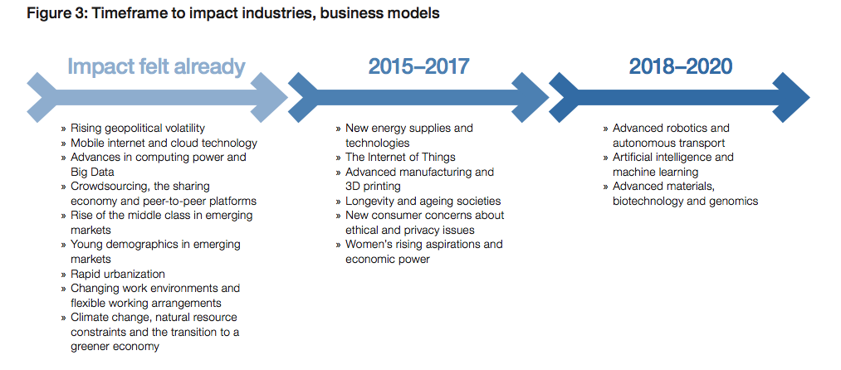
In Summary
Future of Work Report; World Economic Forum, 2017

Slide 17
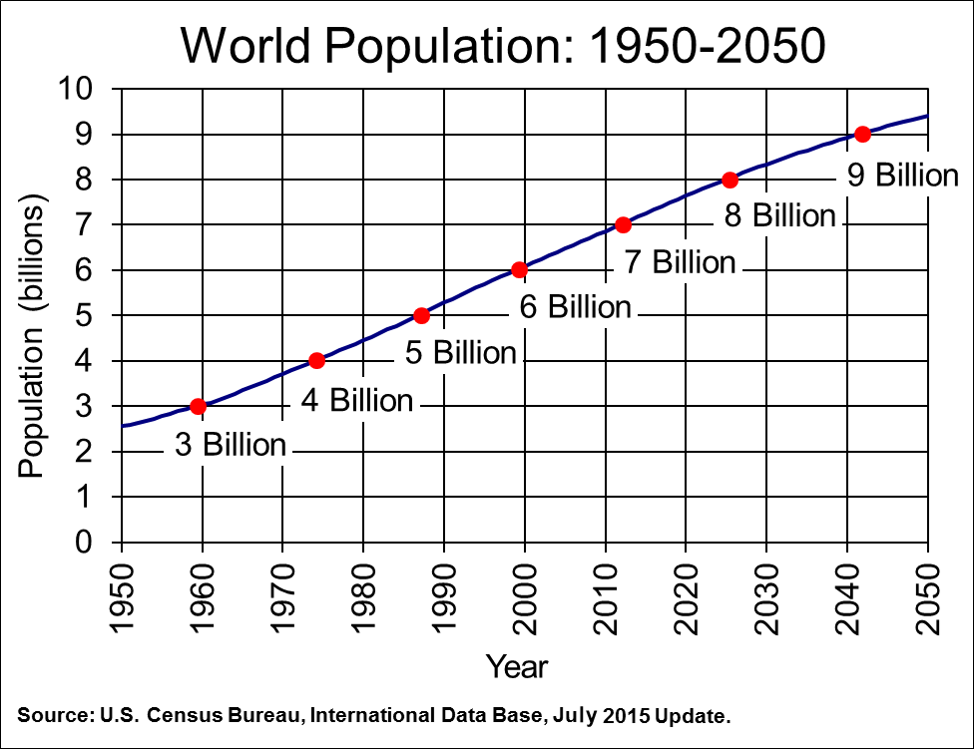
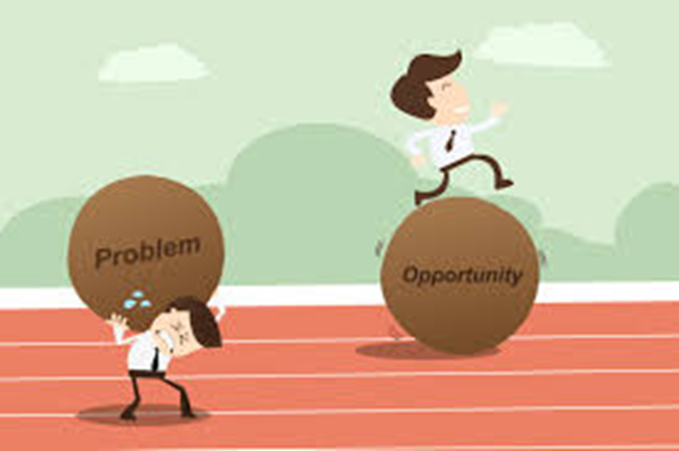
Agri of Tomorrow
The Agri World of Work in 2030

Slide 18

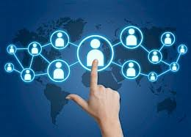
Future Agri World of Work
Open UP! Virtualize

Slide 19
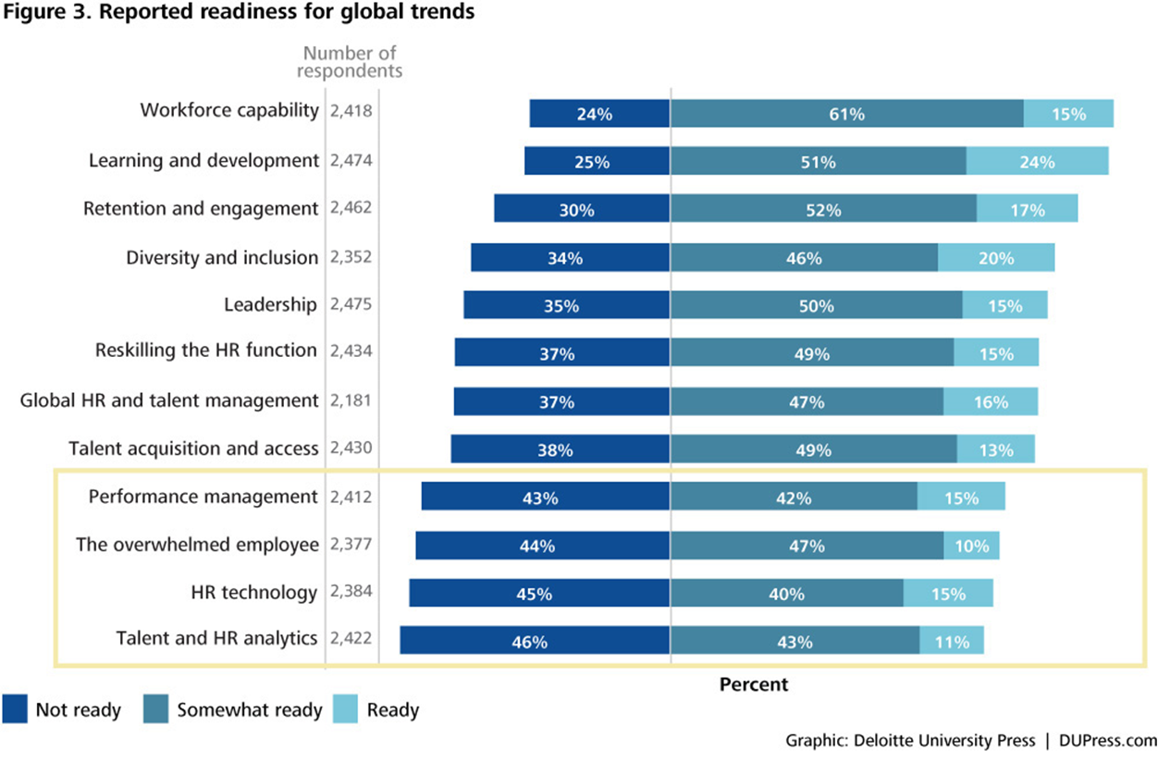
HCM of the Future

Slide 20
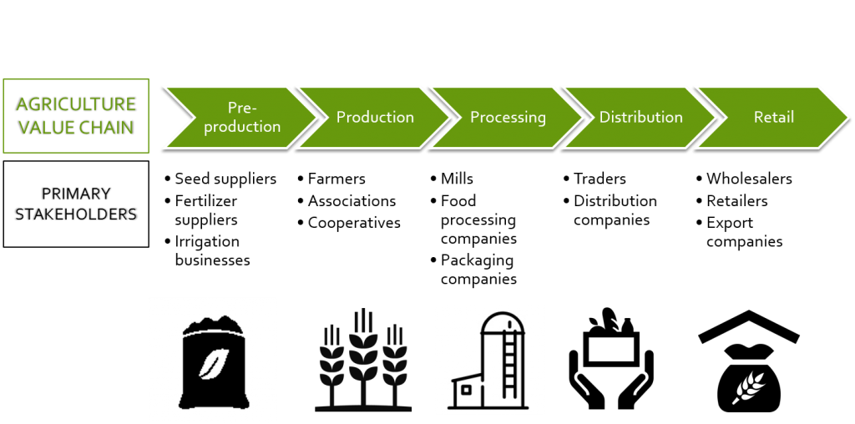
Future Agri World of Work
Pull the Chain
Stop thinking agriculture, start thinking food!

Slide 21
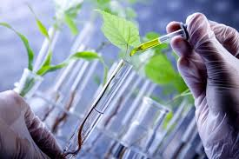
Future Agri World of Work
Control the Remote
On a global level, climate change could be one of the biggest challenges
We need to adjust to producing more crops on the same amount of land or less. This is caused by erosion and the reduced amount of available land and water, so new plants may need to survive with less water.
To pursue a career in agricultural research, important areas of study are biotechnology, genomics, breeding, and agronomy. Within biotechnology, one emerging area for talent is bioinformatics, which is the combination of biology and information technology.

Slide 22
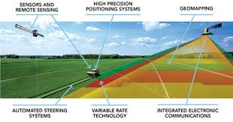
Future Agri World of Work
When people think of farming, they typically conjure up images of a tractor slowly pacing the red soiled land, blowing large plumes of exhaust into the air.
This image will become a distant memory as automated machines, drones, and swarmbots enter the pictures. Many micro-forces will be driving the changes in future agriculture. But there are three dominant trend lines
– precision, relevance, and control –
that will be driving this industry.
Farms, then, are becoming more like factories: tightly controlled operations for turning out reliable products, immune as far as possible from the vagaries of nature.
Future Farm!
If agriculture is to continue to feed the world, it needs to become more like manufacturing, says Geoffrey Carr.

Slide 23
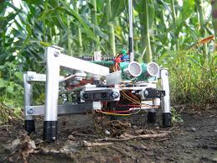
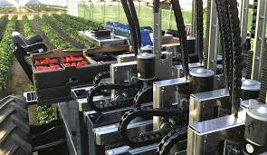
Future Agri World of Work
A generation of young farmer entrepreneurs controlling an army of agbots via an app on their phone is not science-fiction anymore. The use of open source software and the sharing of information can make technology and information transfer affordable for developing countries and farmers.
Agboticize

Slide 24
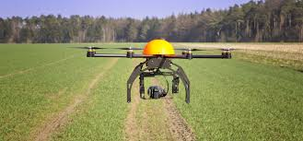
Future Agri World of Work
Understanding a crop’s DNA sequence also means that breeding itself can be made more precise. You do not need to grow a plant to maturity to find out whether it will have the characteristics you want. A quick look at its genome beforehand will tell you.
Such technological changes, in hardware, software and “liveware”, are reaching beyond field, orchard and byre. Fish farming will also get a boost from them. And indoor horticulture, already the most controlled and precise type of agriculture, is about to become yet more so.
What started in farm equipment is moving into the field – at least in the developed world. More and more data is available as farmers use sensors for soil sampling and mobile apps, cameras and drones to monitor pests and diseases. Data science teams are using satellite imagery married with historical records to predict crop yields around the world. A bounty of data for machine learning and image recognition has been supported by continual advances in computing power.
Digitize
Own the Data and you will own the farm!

Slide 25
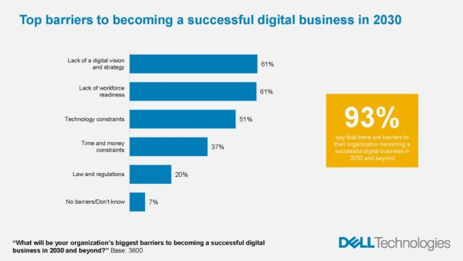

The World of Work in 2030
Don’t focus all the attention on new initiatives at the expense of huge efficiency gains in existing areas of activity.
Secondly, technology and innovation will continue to disrupt this strategic map so embrace them, don’t reject them.
Thirdly, don’t strive for perfection at the expense of progress.

Slide 26
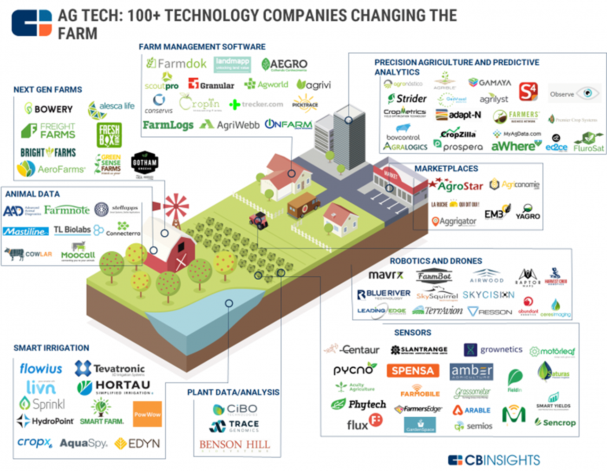
Future Agri World of Work
Play in the Sand Put

Slide 27
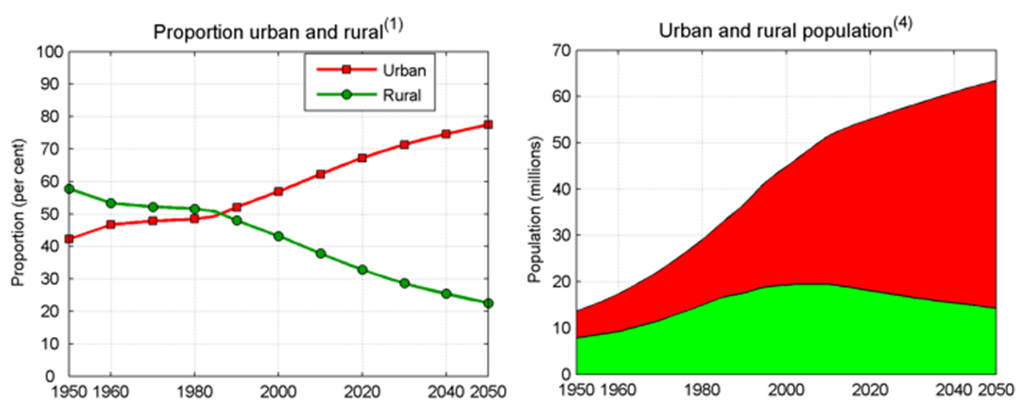
Future Agri World of Work
Urbanize
To invest in old warehouses in urban areas is the way of the future

Slide 28
Future Agri World of Work
In SA, 10 universities offer agriculture from first degree to doctoral level, but most universities of technology have agricultural programmes. In 2010, there were 10,775 enrolments in agricultural science (including postgraduate), which rose to 14,173 in 2014. The graduations were substantially lower than the enrolments: 2,465 in 2010 and 3,278 in 2014.
About 1,500 students are registered for agriculture-related programmes across all public technical and vocational education and training colleges, according to an unpublished 2016 paper commissioned as part of the Assaf study. Vocational training colleges consistently fail to attract students, in part because of the South African fixation on university skills over vocation training, but also because of the variable quality. The national certificate vocational in primary agriculture, according to the study, has only had 170 graduates, with only one in three students completing the course.
The systems used to create colleges centuries ago seems justifiably primitive by today’s standards. Learning formulas for nearly every degree are based on hours, one of the least important considerations when it comes to assessing talent. Colleges today cost far too much, and they take far too long. For this reason, a new wave of full-immersion skill training centers, or Micro Colleges, has begun to emerge.
Optimize Talent!
Nugget Train is not the KFC distribution strategy!

Slide 29
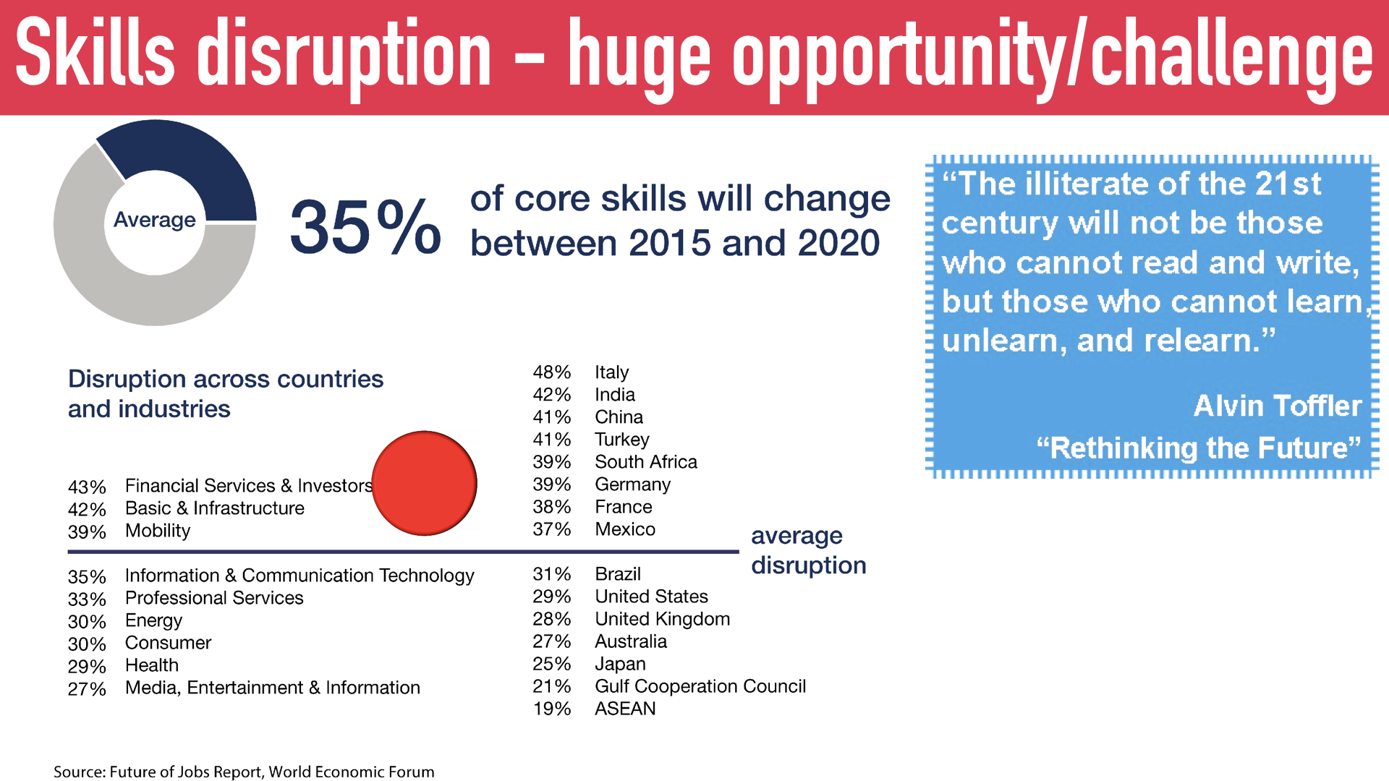
Skills of the Future
Bureau of Labor Statistics (BLS)

Slide 30

Future Agri World of Work
An estimated 849 000 people are employed in the Agri sector, according to data released by Statistics South Africa in 2017. This accounts for about 6% of South Africa’s total employment figures.
The National Development Plan (NDP) reports that “agriculture has the potential to create close to one million new jobs by 2030, a significant contribution to the overall employment target”
There was still a growth of 39 000 jobs in this sector in Q4 of 2017
Align Talent!
US in 1900, 41% of the US workforce was employed in agriculture but that, by 2016, that had fallen to < 2%

Slide 31

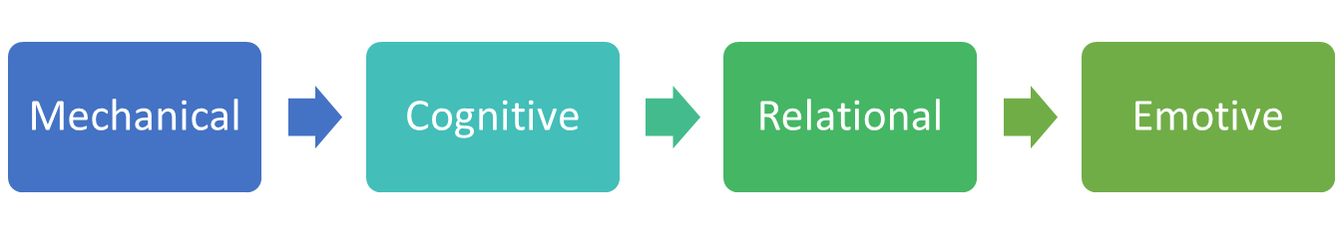
Skills of the Future
New skills for New Jobs.
These jobs may look distinctly different from those they replace. Just as past mechanisation freed, or forced, workers into jobs requiring more cognitive dexterity, leaps in machine intelligence could create space for people to specialise in more emotive occupations, as yet unsuited to machines: a world of artists and therapists, love counsellors and yoga instructors.
Bureau of Labor Statistics (BLS)

Slide 32
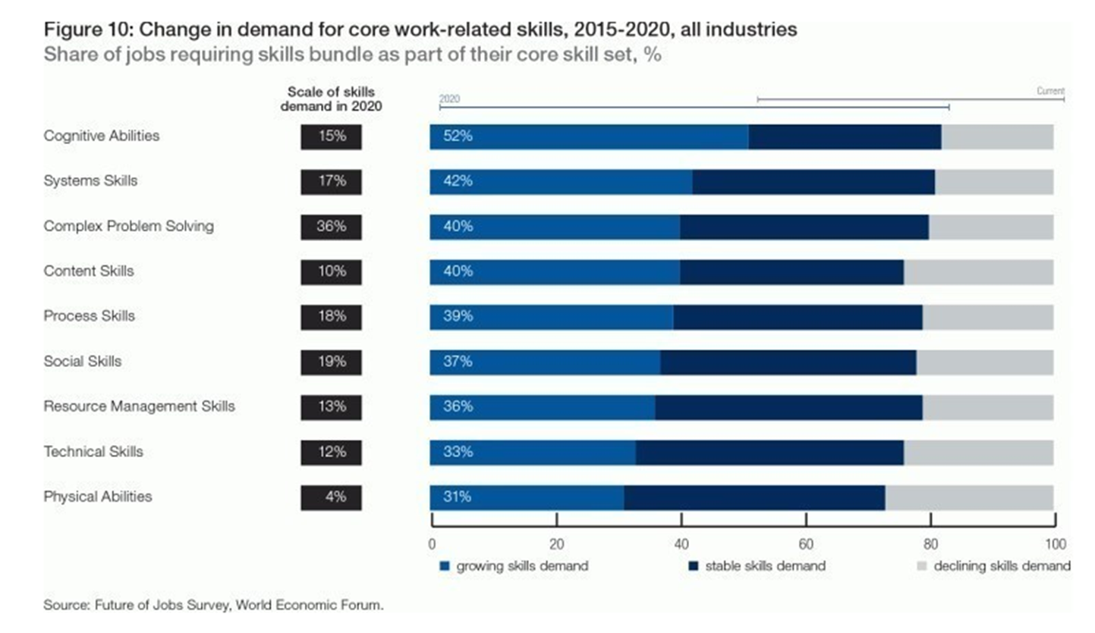

Skills of the Future

Slide 33
Skills of the Future
Computational thinking – the ability to manage the massive amounts of data we process individually each day, spot patterns, and make sense out of all of it.
Virtual collaboration – agility in a highly flexible, global environment
Lifelong fast track development- responsive to nugget training
Understanding how the new generation corporations work- even if you’re working for a company, you have to have a better understanding than ever of how the business operates
Collaboration and project based work - It’s how the millennial generation has been raised. They are more in tune to collaborate
Originality -The ability to come up with unusual or clever ideas about a given topic or situation, or to develop creative ways to solve a problem.
Profound Physical and Mental Strength

Slide 34

HCM of the Future
Virtual Guide
Business Partner
Transitionist
Strategic Business Partner
Expert
Specialized Expertise
Enforcer
Control and Compliance
Administrator
Basic Personnel Services

Slide 35


What Quadrant are you playing in?
Processes
People

